Slide 1


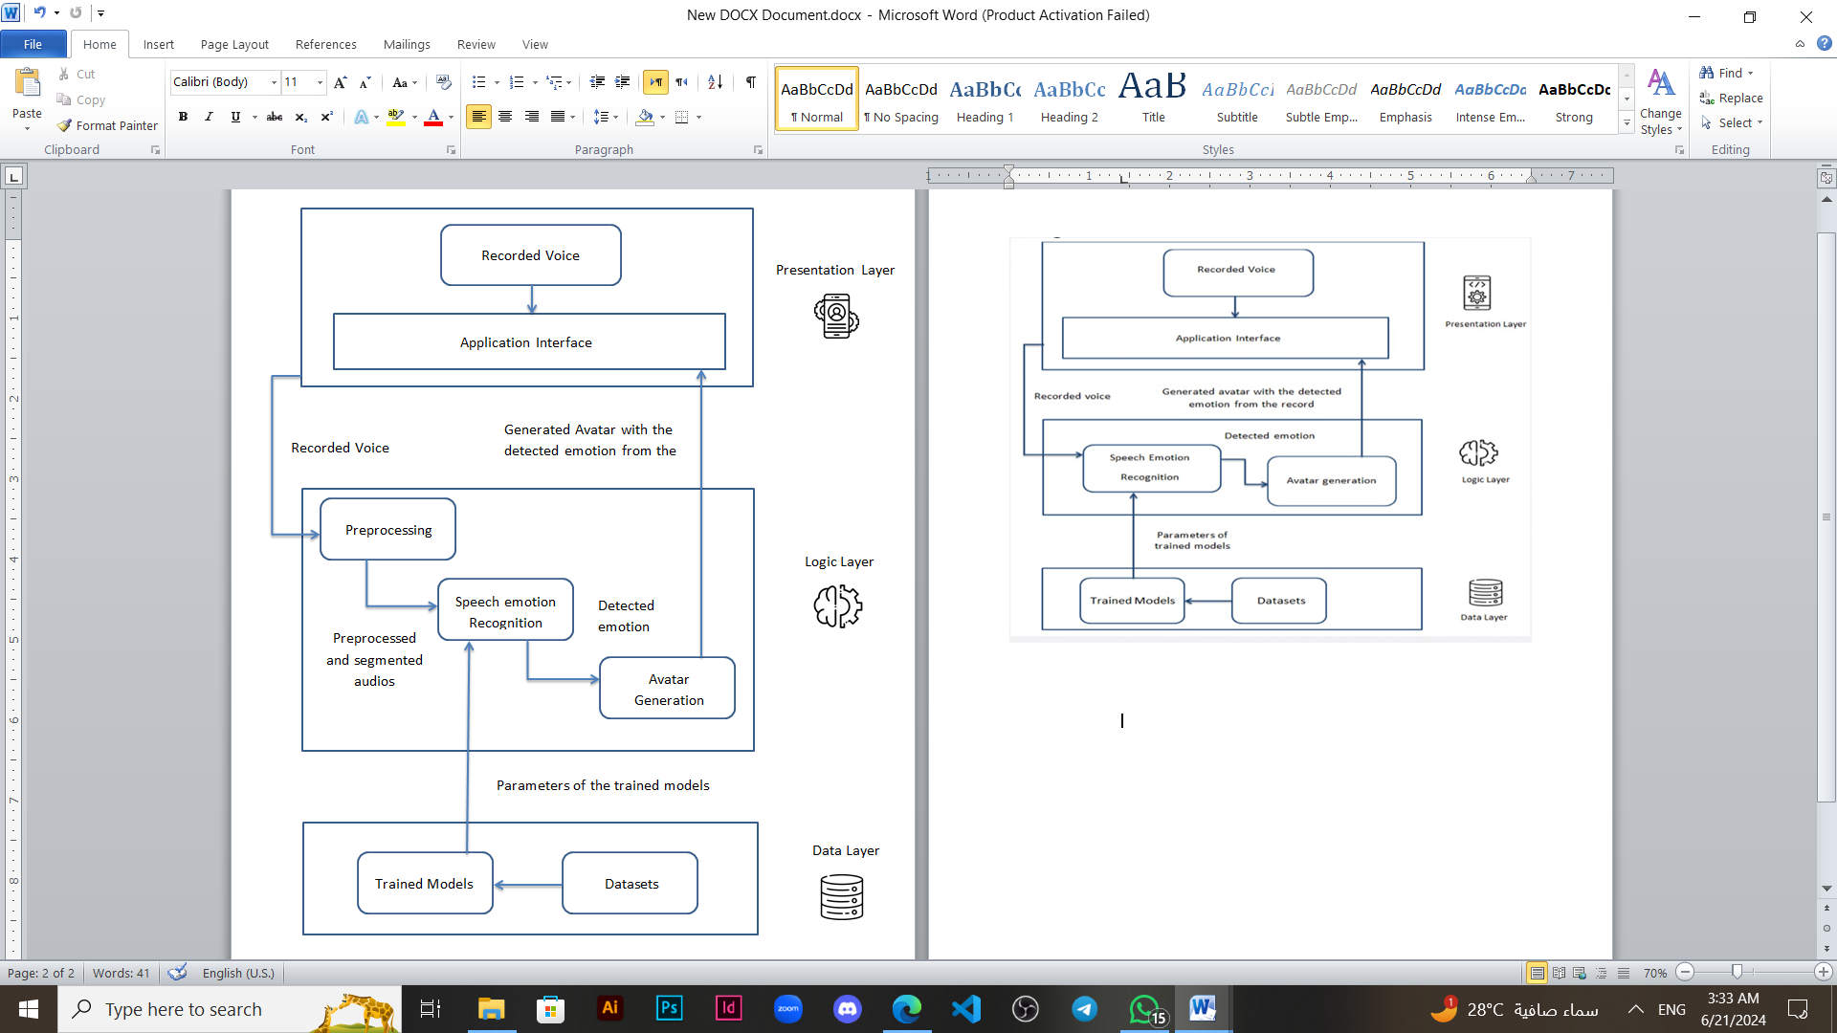
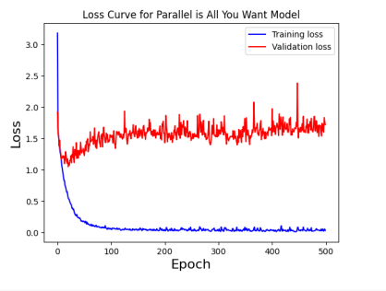
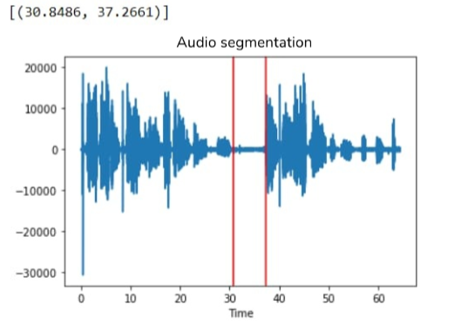




Audio Mood Visualizer
(Automatic Speech Emotion Visualization Through Avatars)
Alaa Salah ,Amany Elsayed, Nour Elhoda Ahmed ,Mai Adel ,Nourhan Adel ,Omnia Ahmed
Supervisors : Dr. Hanan Hindy , AL. Yomna Ahmed
Computer Science Department - Faculty of Computer and Information Science - Ain Shames University
Abstract
To generate the emotional video:
Audio preprocessing.
Emotion detection of the segmented audio using the CNN and multi-head convolution transformer model.
Avatar generation for each individual audio segment and then the video is generated
Our project focuses on enhancing emotional communication for individuals with social phobia by visualizing emotions through avatars based on audio signals. Using advanced Speech Emotion Recognition (SER) techniques, we employed a model combining CNN and Multi-Head Convolutional Transformer, achieving 95% accuracy with the RAVDESS dataset. This system helps those who find verbal communication challenging by simulating the detected emotions of a speaker in an appropriate avatar.
Results
We applied extensive experiments using different models and datasets. The CNN and multi-head convolution transformer deep learning model[1] was used for recognizing the emotions from audio. This model showed the best accuracy among our experiments. Table 1 shows the result between our result using the CNN and multi-head convolution transformer model[1] and the other models on RAVDESS dataset.
Introduction
Speech Emotion Recognition (SER) aids communication for people with social phobias, enhances gaming, and helps teachers understand students' emotions while protecting privacy with avatars. The project aims to detect and classify emotions from audio signals, involving recognition, classification, feature extraction, model training, and real-time processing. Challenges include the subjectivity of emotions, difficulty in labeling, and extracting emotions solely from audio. the application visualizes these emotion through an avatar without the need for opening the camera.
Table 1 – Different models results comparison
Model | Accuracy
SER using machine learning | 80%
SER using CNN and multi-head convolution transformer | 82.31%
SER using Wav2vec 2.0 embedding | 64.3%
Our result using the CNN and multi-head convolution transformer model[1] | 95%
Methodology
In Table 2 show the result of our result using the CNN and multi-head convolution transformer model[1] on different datasets.
Figure 1 shows Our system architecture that consists of multiple layers; presentation , logic and data layer. The logic layer contains three main subprocesses that complete our framework.
Table 2 – Results of our result using the CNN and multi-head convolution transformer model[1] on different datasets
Dataset | Accuracy
RAVDESS | 95%
SAVEE | 62.5%
RAVDESS & SAVEE | 72.5%
Figure 5 shows the training and validation loss that is used for visualization to make sure that the model was not overfitting and for early stopping.
Figure 5 -Loss Curve for CNN and Multi-Head Convolutional Transformer model
Figure 1 – System architecture
After detecting the emotion, we visualize the result through avatars by creating a video that has the selected avatar as the main actor showing emotions clearly for every sentence in the audio.
Preprocessing:
In preprocessing module, MFCCs are extracted from audio then segmentation is applied on the audio, as shown in figure 2, in order to split the long audio into smaller statements.
Our best results were obtained using the CNN and multi-head convolution transformer model from [1]. However, in our experiments, we were able to acquire different accuracies, this could be due to applying shuffling in preprocessing
Conclusion
Figure 2 – Split the audio by detecting the silence
The project visualizes emotions from speech using avatars via Speech Emotion Recognition and avatar generation. We used CNN, Multi-Head Convolutional Transformer, and LSTM models on datasets like RAVDESS, SAVEE, and TESS. The CNN and Multi-Head Convolutional Transformer model on RAVDESS had the best accuracy, distinguishing "angry" and "sad" emotions well but struggled with "calm" and "neutral." Avatar attributes were combined to reflect detected emotions, and versions with open and closed mouths were created to simulate speech, resulting in a video that visualizes emotional expression.
Avatar generation:
Customized avatars are generated based on the detected emotions from the model and they are put into an array according to the sequence of the emotions detected in the audio. Examples for avatars are shown in figure 3 and figure 4.
References
[1] H. Attar, N. Kadole, O. Karanjekar, D. Nagarkar and S. More , "Speech Emotion Recognition System Using Machine Learning", International Journal of Research Publication and Reviews, vol. 3, no. 5, pp. 2869-2880, May 2022.
[2] H. S. Kumbhar and S. U. Bhandari, "Speech Emotion Recognition using MFCC features and LSTM network", Jun. 2020, doi:10.1109/ICCUBEA47591.2019.9129067.
Figure 3 – old female happy
Figure 4 – middle male fearful

